Slide 1
Hidden Markov Models
John Goldsmith

Slide 2
Markov model
A markov model is a probabilistic model of symbol sequences in which the probability of the current event is conditioned only by the previous event.

Slide 3
Symbol sequences
Consider a sequence of random variables X₁, X₂, …, X_{N.} Think of the subscripts as indicating word-position in a sentence.
Remember that a random variable is a function, and in this case its range is the vocabulary of the language. The size of the “pre-image” that maps to a given word w is the probability assigned to w.

Slide 4
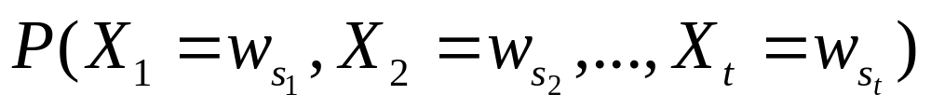
What is the probability of a sequence of words w₁…w_{t}? This is…
P(X₁ = w₁ and X₂ = w₂ and…X_{t} = w_{t})
The fact that subscript “1” appears on both the X and the w in “X₁ = w₁“ is a bit abusive of notation. It might be better to write:

Slide 5
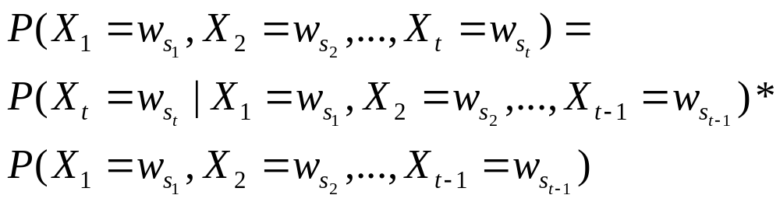
By definition…
This says less than it appears to; it’s just a way of talking about the
word “and” and the definition of conditional probability.

Slide 6
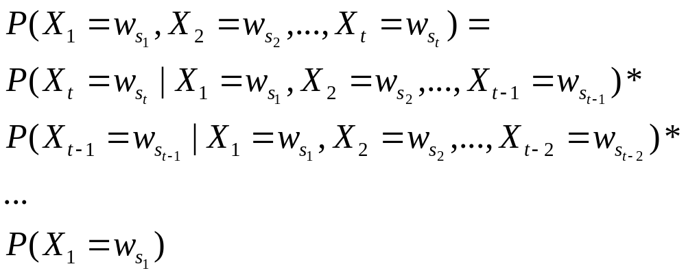
We can carry this out…
This says that every word is conditioned by all the words preceding it.

Slide 7
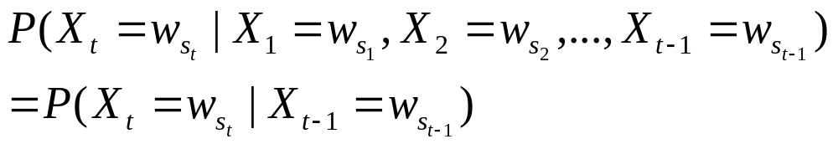
The Markov assumption
What a sorry assumption about language!
Manning and Schütze call this the “limited horizon” property of the model.

Slide 8
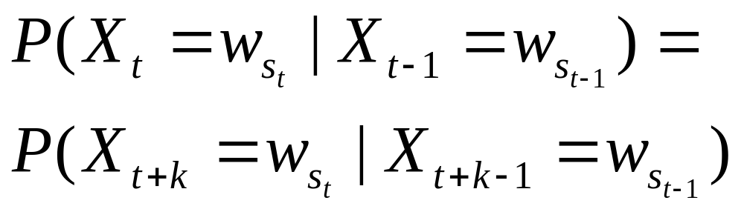
Stationary model
There’s also an additional assumption that the parameters don’t change “over time”:
for all (appropriate) t and k:

Slide 9
0.8
appeared
dog
big
0.6
0.2
0.5
0.4
the
just
0.2
0.4
0.4
0.5
0.8
1
cat
old
died
0.2
P( “the big dog just died” ) = 0.4 * 0.6 * 0.2 * 0.5

Slide 10
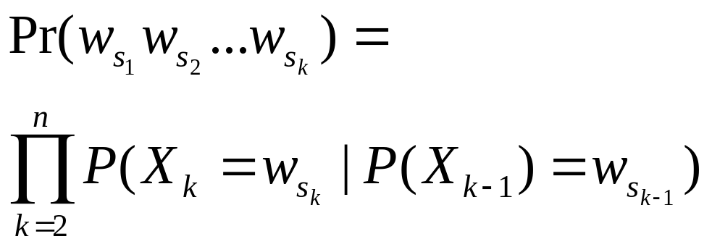
Prob ( Sequence )

Slide 11
Hidden Markov model
An HMM is a non-deterministic markov model – that is, one where knowledge of the emitted symbol does not determine the state-transition.
This means that in order to determine the probability of a given string, we must take more than one path through the states into account.

Slide 12
Relating emitted symbols to HMM architecture
There are two ways:
State-emission HMM (Moore machine): a set of probabilities assigned to the vocabulary in each state.
Arc-emission HMM (Mealy machine): a set of probabilities assigned to the vocabulary for each state-to-state transition. (More parameters)

Slide 13
State emission
p(a) = 0.2
p(b) = 0.7
…
p(a) = 0.2
p(b) = 0.7
…
p(a) = 0.2
p(b) = 0.7
…
0.15
0.15
0.85
0.85
0.75
0.75
0.25
0.25
p(a) = 0.7
p(b) = 0.2
…
p(a) = 0.7
p(b) = 0.2
…
p(a) = 0.7
p(b) = 0.2
…

Slide 14
Arc-emission (Mealy)
p(a) =.03, p(b)=.105,…
p(a) =.03, p(b)=.105,…
p(a) =.17, p(b)=.595,…
p(a) =.17, p(b)=.595,…
p(a) = 0.525, p(b)=.15, …
p(a) = 0.525, p(b)=.15, …
p(a)= 0.175, p(b)=0,05,…
p(a)= 0.175, p(b)=0,05,…
Sum of prob’s leaving each state sum to 1.0

Slide 15
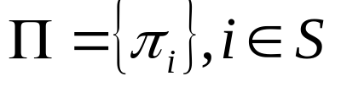
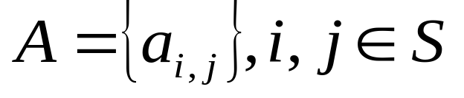
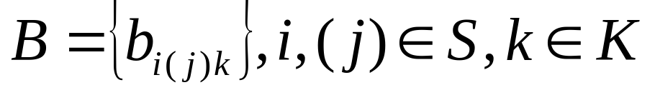
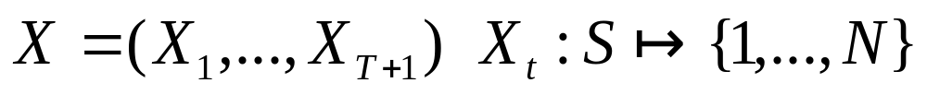
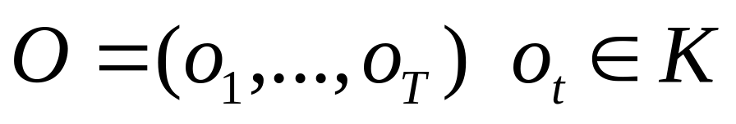
Definition
Set of states S={s₁, …, s_{N}}
Output alphabet K = {k₁,…,k_{M}}
Initial state probabilities
State transition probabilities
Symbol emission probabilities
State sequence
Output sequence

Slide 16
Follow
“ab” through the HMM
Using the state emission model:

Slide 17
State to state transition probability
 | State 1 | State 2
State 1 | 0.15 | 0.85
State 2 | 0.75 | 0.25

Slide 18
State-emission symbol probabilities
State 1 | State 2
pr(a) = 0.2 | pr(a) = 0.7
pr(b) = 0.7 | pr(b) = 0.2
pr(c) = 0.1 | pr(b) = 0.1

Slide 19
½ * 0.2 * 0.85 = 0.085
½*0.2 * 0.15 = 0.015
0.015 + 0.263 = .278
p(b) = 0.7
…
p(a) = 0.2
0.15
0.15
ε
0.85
0.85
0.5
Start
0.75
0.75
ε
0.5
0.25
0.25
p(b) = 0.2
p(a) = 0.7
0.082 + 0.085 = 0.167
½*0.7 * 0.25 = .082
½* 0.7 * 0.75 = 0.263

Slide 20
0.015 + 0.263 = .278
pr( produce (ab) & this state ) = .278 * 0.7 = 0.1946
p(b) = 0.7
…
p(a) = 0.2
0.15
0.85
0.75
0.25
p(b) = 0.2
p(a) = 0.7
0.082 + 0.085 = 0.167
pr(produce(ab) & this state)
= 0.167 * 0.2
= 0.0334

Slide 21
P( produce (b) ) = .278 * 0.7 = 0.1946
0.1946 * 0.15 = 0.0292
p(b) = 0.7
…
p(a) = 0.2
0.15
0.054
0.85
0.033 * 0.75
= .0248
0.75
0.1946 * 0.85
= 0.165
0.25
0.173
p(b) = 0.2
p(a) = 0.7
P(produce(b)) = 0.167 * 0.2
= 0.0334
0.033 * 0.25 = 0.0082

Slide 22
winner
p(b) = 0.7
…
p(a) = 0.2
0.15
0.194
0.054
0.85
0.75
0.25
0.173
0.033
winner
p(b) = 0.2
p(a) = 0.7

Slide 23
What’s the probability of “ab”?
p(b) = 0.7
…
p(a) = 0.2
0.15
0.194
0.054
0.85
0.75
0.25
0.173
0.033
p(b) = 0.2
p(a) = 0.7
Answer: 0.054 + 0.173 – the sum of the probabilities of the ways of
generating “ab” = 0.227. This is the “forward” probability calculation.

Slide 24
That’s the basic idea of an HMM
Three questions:
Given a model, how do we compute the probability of an observation sequence?
Given a model, how do we find the best state sequence?
Given a corpus and a parameterized model, how do we find the parameters that maximize the probability of the corpus?

Slide 25

Probability of a sequence
Using the notation we’ve used:
Initialization: we have a distribution of probabilities of being in the states initially, before any symbol has been emitted.
Assign a distribution to the set of initial states; these are π (i), where i varies from 1 to N, the number of states.

Slide 26
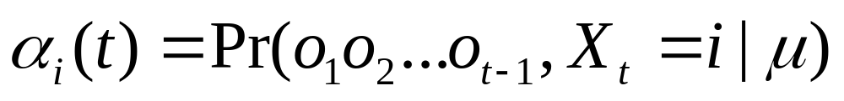
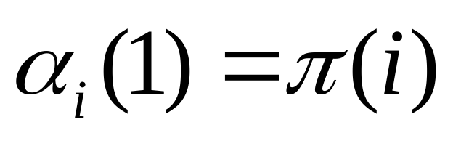
We’re going to focus on a variable called forward probability, denoted α.
α_{i}(t) is the probability of being at state s_{i} at time t, given that o₁,…,o_{t-1} were generated.

Slide 27
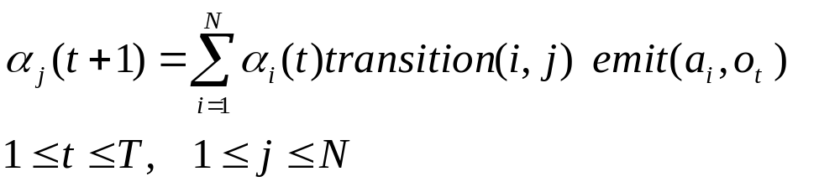
Induction step:
Transition from state i to this state, state j
Probability at state i in previous “loop”
Probability of emitting the
right word during that
particular transition. (Having
2 arguments here is what
makes it state-emission.)

Slide 28
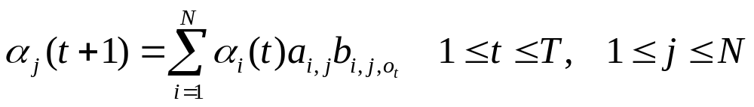
Side note on arc-emission: induction stage
Transition from state i to this state, state j
Probability at state i in previous “loop”
Probability of emitting the
right word during that
particular transition

Slide 29
Forward probability
So by calculating α, the forward probability, we calculate the probability of being in a particular state at time t after having “correctly” generated the symbols up to that point.

Slide 30
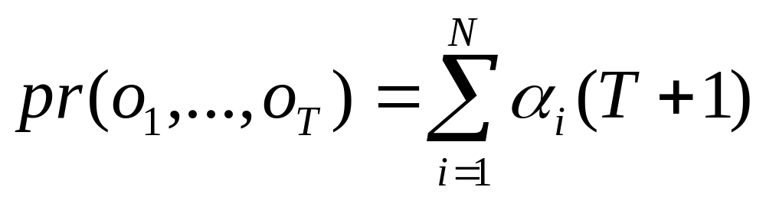
The final probability of the observation is

Slide 31
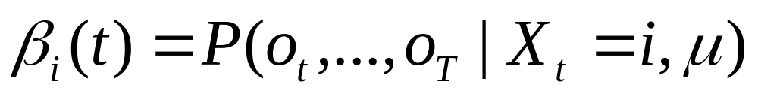
We want to do the same thing from the end: Backward β
This is the probability of generating the symbols
from o_{t} to o_{T}, starting out from state i at time t.

Slide 32
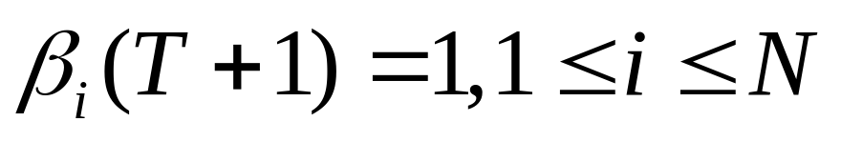
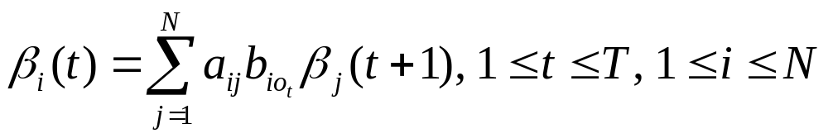
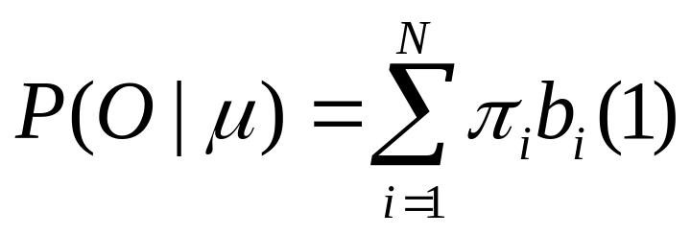
Initialization (this is different than Forward…)
Induction
Total

Slide 33
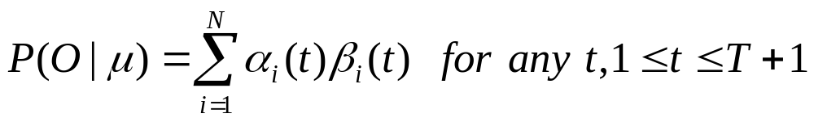
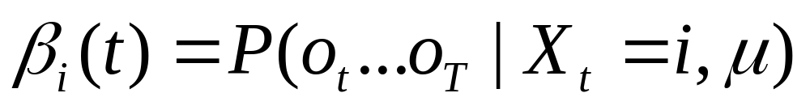
Probability of the corpus:

Slide 34

Again: finding the best path to generate the data: Viterbi
Dr. Andrew Viterbi received his B.S. and M.S. from MIT in 1957 and Ph.D. from the University of Southern California in 1962. He began his career at California Institute of Technology's Jet Propulsion Laboratory. In 1968, he co-founded LINKABIT Corporation and, in 1985, QUALCOMM, Inc., now a leader in digital wireless communications and products based on CDMA technologies. He served as a professor at UCLA and UC San Diego, where he is now a professor emeritus. Dr.Viterbi is currently president of the Viterbi Group, LLC, which advises and invests in startup companies in communication, network, and imaging technologies. He also recently accepted a position teaching at USC's newly named Andrew and Erna Viterbi School of Engineering.

Slide 35
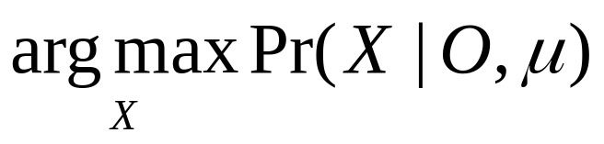
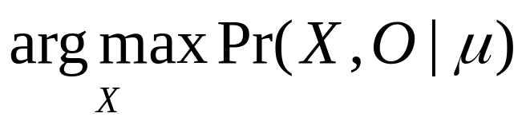
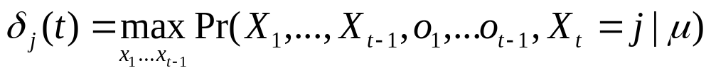
Viterbi
Goal: find
We calculate this variable to keep track
of the “best” path that generates the
first t-1 symbols and ends in state j.

Slide 36
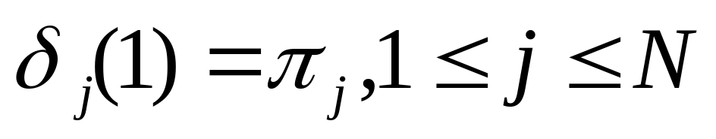
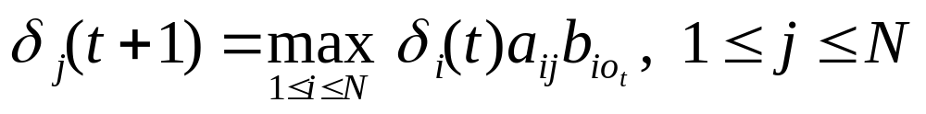
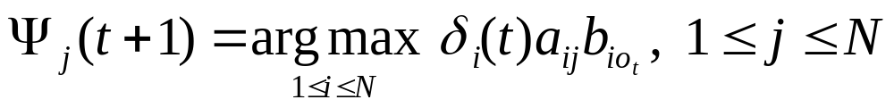
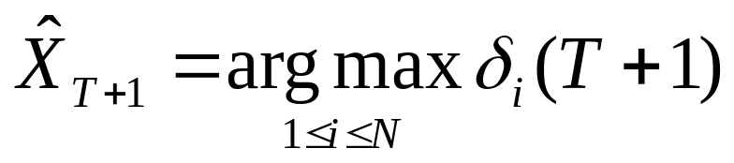
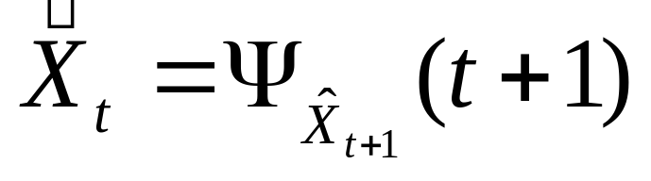
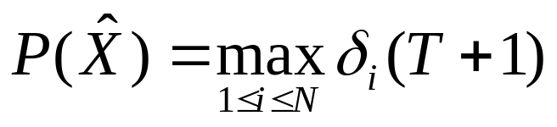
Viterbi
Initialization
Induction
Backtrace/memo:
Termination

Slide 37
Next step is the difficult one
We want to start understanding how you can set (“estimate”) parameters automatically from a corpus.
The problem is that you need to learn the probability parameters, and probability parameters are best learned by counting frequencies. So in theory we’d like to see how often you make each of the transitions in the graph.

Slide 38
Central idea
We’ll take every word in the corpus, and when it’s the i^{th} word, we’ll divide its count of 1.0 over all the transitions that it could have made in the network, weighting the pieces by the probability that it took that transition.
AND: the probability that a particular transition occurred is calculated by weighting the transition by the probability of the entire path (it’s unique, right?), from beginning to end, that includes it.

Slide 39
Thus:
if we can do this,
Probabilities give us (=have just given us) counts of transitions.
We sum these transition counts over our whole large corpus, and use those counts to generate new probabilities for each parameter (maximum likelihood parameters).

Slide 40
Here’s the trick: word “w” in the utterance S[0…n]
each line represents
a transition emitting
the word w
probabilities from each state
(from Backward)
probabilities of each
state (from Forward)

Slide 41
prob of a transition line = prob (starting state) *
prob (emitting w) * prob (ending state)
each line represents
a transition emitting
the word w
probabilities from each state
(from Backward)
probabilities of each
state (from Forward)

Slide 42
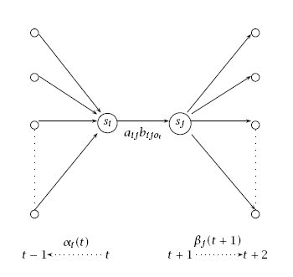

Slide 43
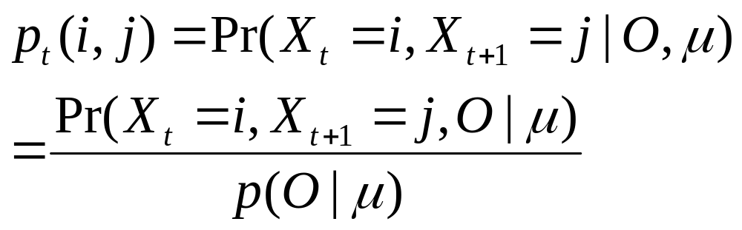
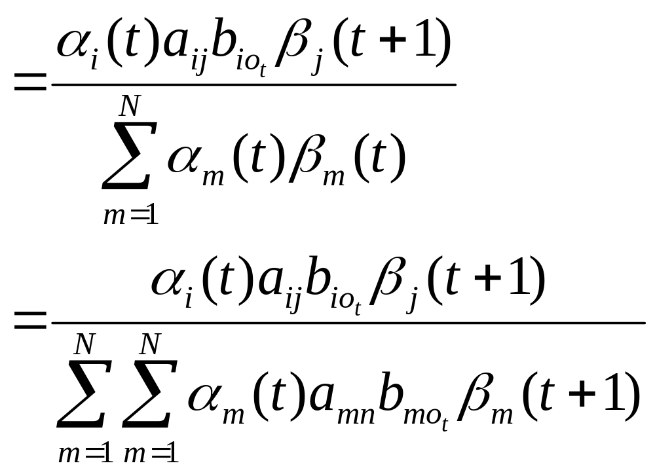
probability of transition,
given the data
we don’t need to
keep expanding the
denominator –
we are doing that just
to make clear how the
numerator relates to the
denominator
conceptually.

Slide 44
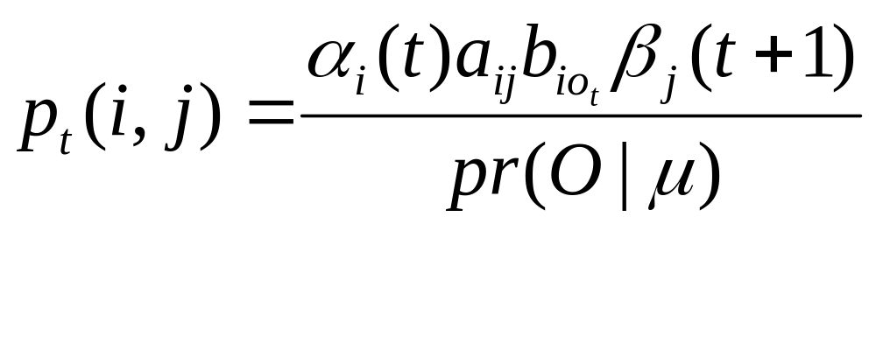
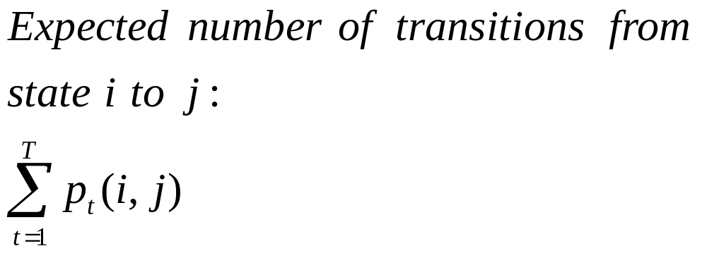
Now we just sum over all of our observations:

Slide 45
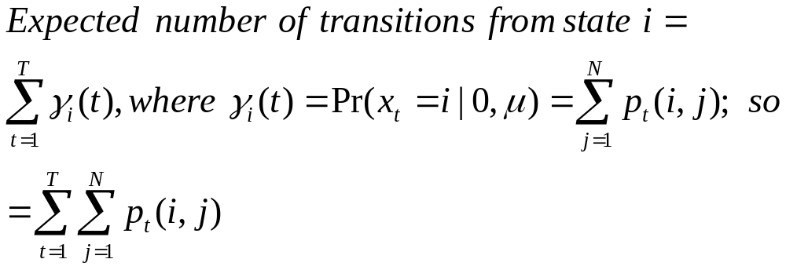
Sum over to-states
Sum over the whole corpus

Slide 46
That’s the basics of the first (hard) half of the algorithm
This training is a special case of the Expectation-Maximization (EM) algorithm; we’ve just done the “expectation” half, which creates a set of “virtual” or soft counts – these are turned into model parameters (or probabilities) in the second part, the “maximization” half.

Slide 47
Maximization
Let’s assume that there were N-1 transitions in the path through the network, and that we have no knowledge of where sentences start (etc.).
Then the probability of each state s_{i} is the number of transitions that went from s_{i} to any state, divided by N-1.
The probability of a state transition a_{ij} is the number of transitions from state i to state j, divided by the number of probability of state i.

Slide 48
and the probability of making the transition from i to j and emitting word w is:
the number of transitions from i to j that emitted word w, divided by the total number of transitions from from i to j.

Slide 49
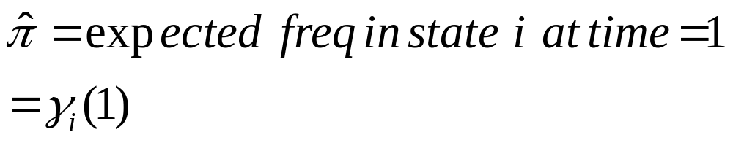
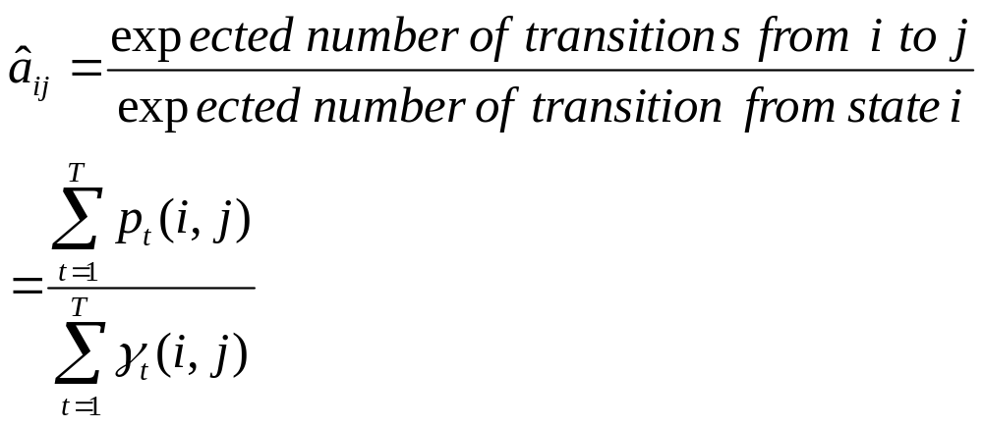
More exactly…

Slide 50
So that’s the big idea.
Application: to speech recognition. Create an HMM for each word in the lexicon, and use that to calculate, for a given input sound P and word w_{i}, what the probability is of P. The word that gives the highest score wins.
Part of speech tagging: in two weeks.

Slide 51
Speech
HMMs in the classical (discrete) speech context “emit” or “accept” symbols chosen from a “codebook” consisting of 256 spectra – in effect, timeslices of a spectrogram.
Every 5 or 10 msec., we take a spectrogram, and decide which page of the codebook it most resembles, and encode the continuous sound event as a sequence of 100 or 200 symbols per second. (There are alternatives to this.)

Slide 52
Speech
The HMMs then are asked to generate the symbolic sequences produced in that way.
Each word can assign a probability to a given sequence of these symbols.

Slide 53
Speech
Speech models of words are generally (and roughly) along these lines:
The HMM for “dog” /D AW1 G/ is three successive phoneme models.
Each phoneme model is actually a phoneme-in-context model: a D after # followed by AW1, an AW1 model after D and before G, etc.

Slide 54
Each phoneme model is made up of 3, 4, or 5 states; associated with each state is a distribution over all the time-slice symbols.

Slide 55
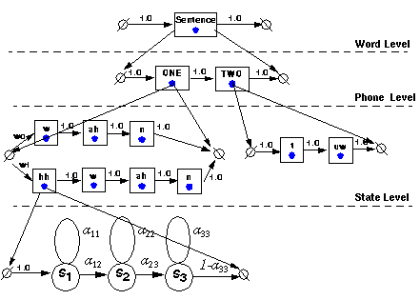
From http://www.isip.msstate.edu/projects/speech/software/tutorials/monthly/2002_05/

